Slide 1

MWSUG BL-101 Exploring and characterizing time series data in a non-regression based approach
Dr. Steven C. Myers
Department of Economics
College of Business Administration
The University of Akron
Myers@uakron.edu
Econdatascience.com
https://www.linkedin.com/in/stevencmyers
This paper and code → https://github.com/campnmug/time

Slide 2
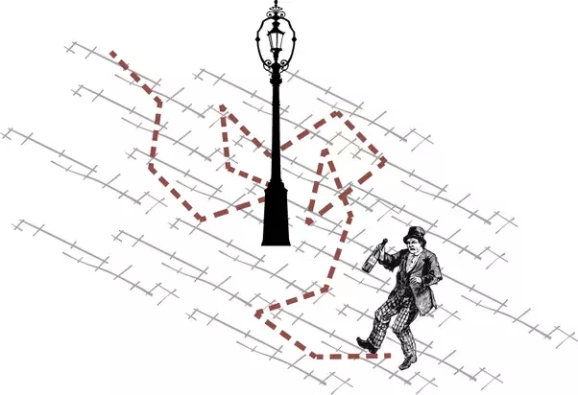

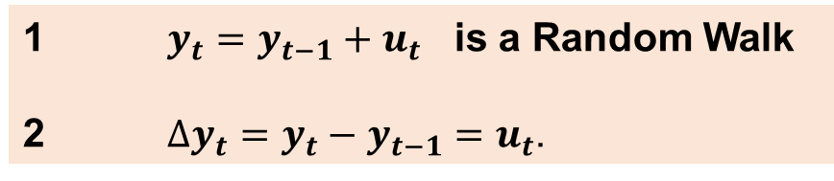

Why investigate time series (before analysis?)
A sober person walks out of a bar and walks down the street.
Every step is planned and predictable.
A drunk stumbles out or a bar and staggers down the street.
Every step is random and unpredictable - hence this is a random walk.
$y_{t}=y_{t−1}+u_{t}$ is a Random Walk
$∆y_{t}=y_{t}−y_{t−1}=u_{t}$.
$y_{t}=y_{t−1}+u_{t}$ is a Random Walk
$∆y_{t}=y_{t}−y_{t−1}=u_{t}$.
Which implies Growth is unpredictable
Image: https://www.quora.com/What-is-a-random-walk

Slide 3
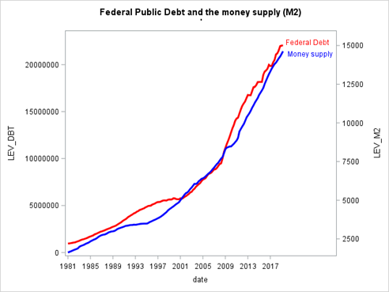
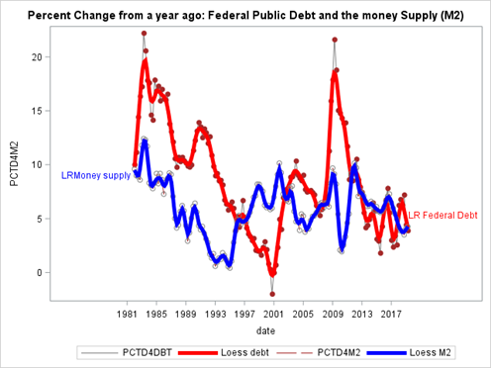


Spurious Regression: Money Supply and Federal Public Debt
$y_{t}=y_{t−1}+u_{t}$
$$∆y_{t}=y_{t}−y_{t−1}=u_{t}$$
R²=.07
R²=.99

Slide 4
This paper, data and code → https://github.com/campnmug/time
Objectives for my talk
Learn the dangers of hasty analysis
Learn that “problem articulation” precedes EDA and Analysis
Learn to develop a EDA mentality as the most valuable time on the project
Learn the importance of the Data Generating Process
Learn how to help analysts make better decisions
Section 1
Examples of data handling
4 ways to acquire data from the marvelous FRED dataset
Characterize the data visually and in tabular form
Learn how to create useful transforms
DIF macro
Explore macro
Section 2
Identification of the DGP
Avoid the pain of random walking
Importance of stationarity
Spurious regression
Other available tests for DGP in PROC AUTOREG and PROC ARIMA

Slide 5
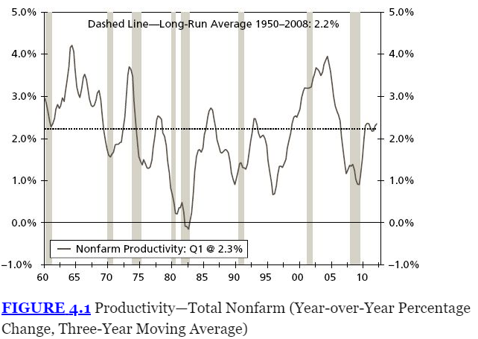
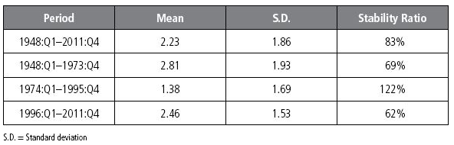
Graph → Plot the series – three questions
See any extreme values?
Unusual event or mistake in data
Does it have a explicit time trend?
Trend? Linear or nonlinear, increasing or decreasing and at what rate
Cyclical pattern that repeats
Is there a structural break?
Indicates a major change in behavior
Table → Simple Statistics over time slices
Mean = Central tendency of a series
S.D. = Measure of volatility
CV = Stability of the series
Total series →
Strong Productivity Growth Era →
Slow Productivity Growth Era →
Productivity Resurgence Era →
Figure 4.1 and Table 4.1 from Silvia

Slide 6
Four ways to acquire data from FRED (Federal Reserve Economic Data)
(1) Downloading Data FROM a FRED graph you have designed.
(2) Downloading data using the Data Lists option under My Account in FRED.
(3) Exporting data Using the FRED Add-in for Microsoft Excel
(4) Acquiring SAS from SASEFRED engine of SAS/ETS

Slide 7
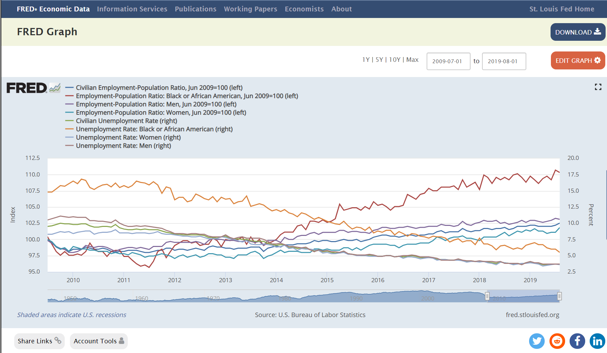
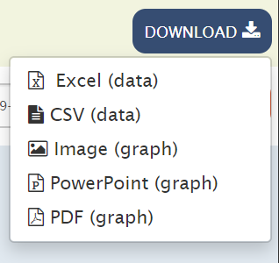
(1) Downloading Data FROM a FRED graph you have designed.
←
Downloads
8 data
series
8 data
series
Accounts
Are free,
and you
can save all
of your work.
https://fred.stlouisfed.org/graph/?g=oEKv

Slide 8
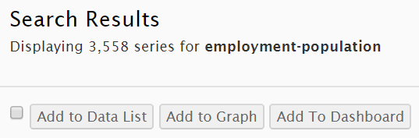
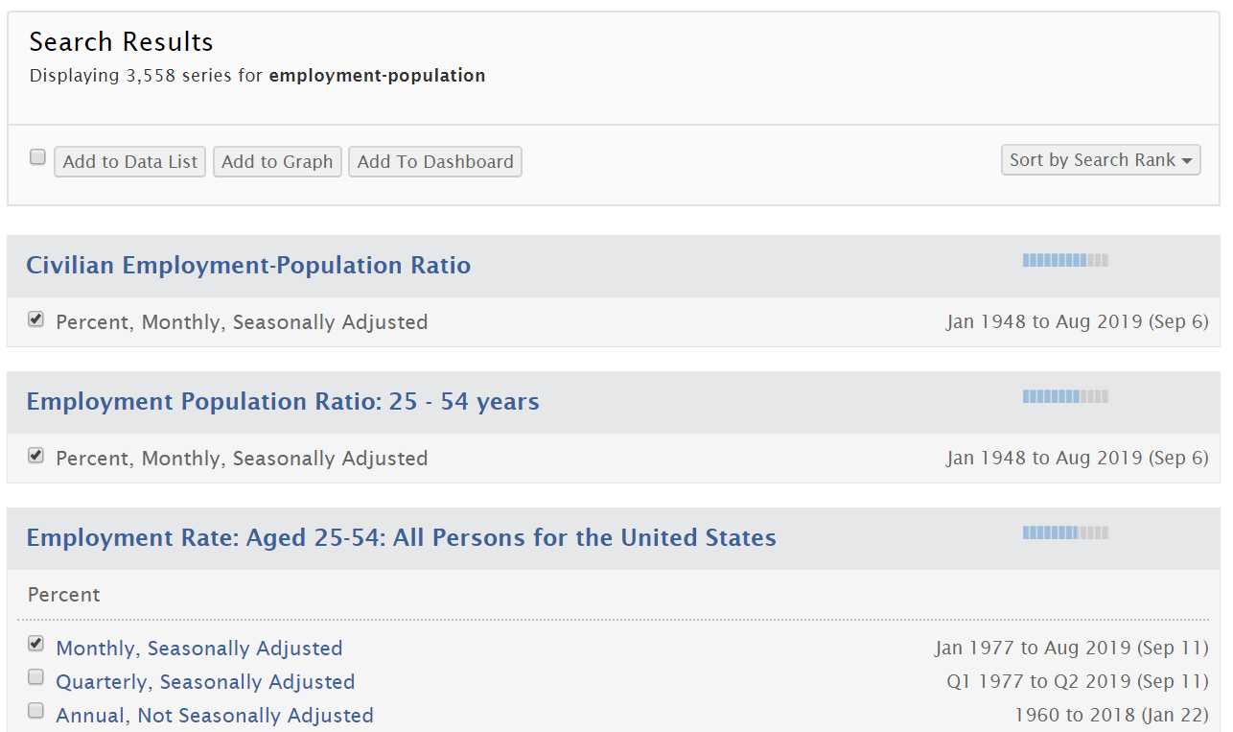
(2) Downloading data using the Data Lists option under My Account in FRED.
https://fred.stlouisfed.org/search/?st=empolyment-population

Slide 9
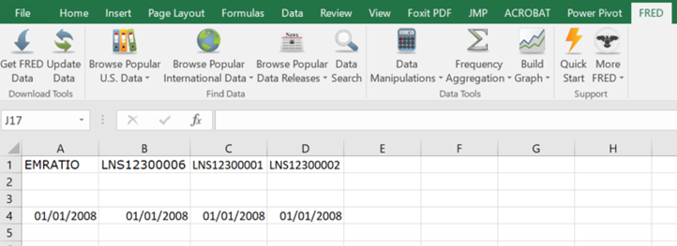
(3) Exporting data Using the FRED Add-in for Microsoft Excel
https://fred.stlouisfed.org/fred-addin

Slide 10
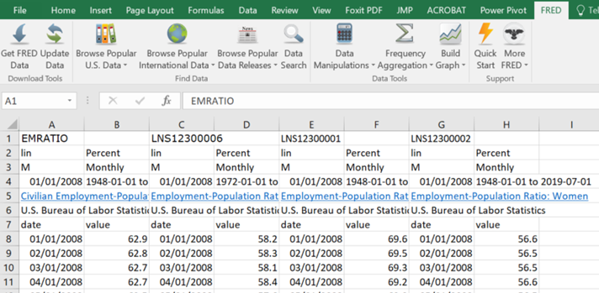
(3) Exporting data Using the FRED Add-in for Microsoft Excel

Slide 11
(1 to 3) Preparing Excel for SAS PROC IMPORT
ORIGINAL TAB- actual downloaded data in original form from FRED
Verify and adjust if all dates and frequencies are not the same
SOURCE TAB - include links to original source, citation and data dictionary
SASDATA TAB - copy of the original tab modified to a SAS legal dataset
put SAS-legal variable names in the place of the words “value” in line 7
delete duplicate date columns and delete rows 1 to 6
PROC IMPORT OUT= WORK.EPOP
DATAFILE= "E-POP-data.xlsx"
DBMS=xlsx REPLACE;
SHEET='sasdata';
RUN;

Slide 12
(4) Acquiring SAS from SASEFRED engine of SAS/ETS
LIBNAME fred SASEFRED "&dir"
OUTXML=epop
XMLMAP="&dir\exportgs.map"
START='2002-01-01'
END='2019-04-01'
APIKEY='xxxxxxxxxxxxxxxxxxxxxxxxxxxxxxxx'
/* IDLIST is comma delimited with no spaces between the single quotes. */
IDLIST='EMRATIO,LNS12300006,LNS12300001,LNS12300002';
data work.export_epop;
set fred.epop ;
run;
proc contents data=work.export_epop; run;
proc print data=work.export_epop(obs=15); run;
Request your 32-character alphanumeric API key here:
https://research.stlouisfed.org/docs/api/api_key.html

Slide 13
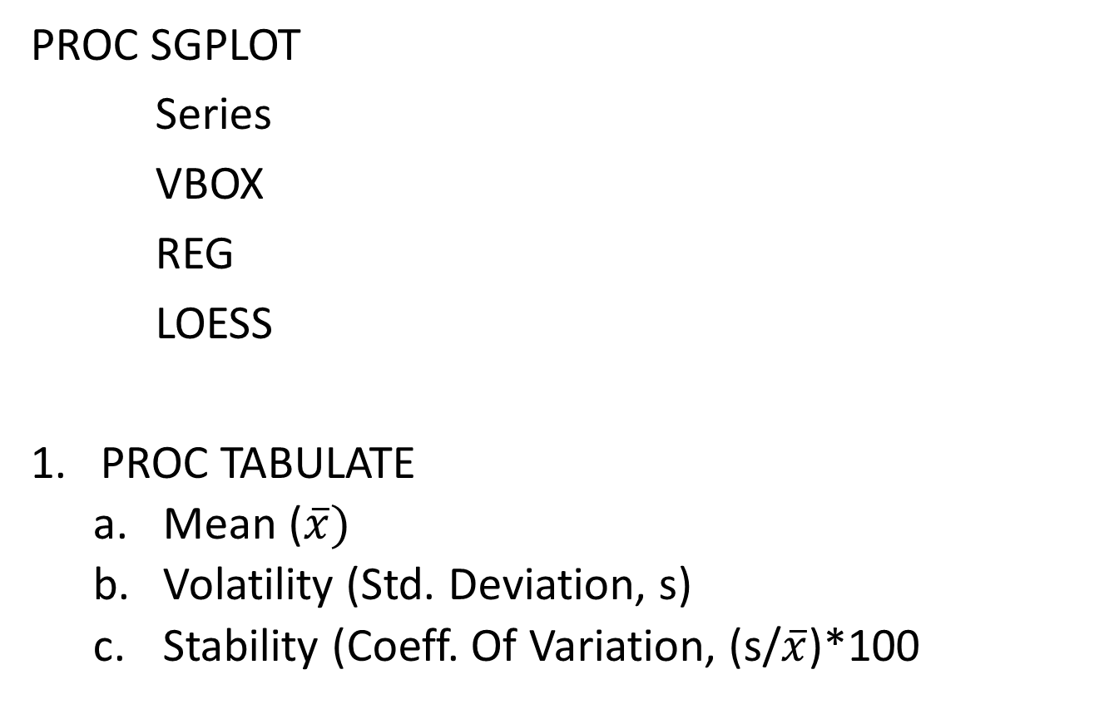
Characterizing Time Series to discover The data generating process
Central tendency of a series (Mean)
Measure of volatility (Standard Deviation)
Stability of the series (CV = coefficient of variation)
PROC SGPLOT
Series
VBOX
REG
LOESS
PROC TABULATE
Mean ($\overline{x})$
Volatility (Std. Deviation, s)
Stability (Coeff. Of Variation, (s/$\overline{x}$)*100

Slide 14
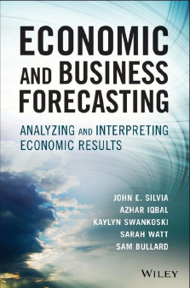
Characterizing Time Series using Graphs
See any extreme values?
Unusual events or
Mistake in data
Does it have a explicit time trend?
Linear or nonlinear,
Increasing or decreasing and at what rate
Cyclical pattern that repeats
Is there a structural break?
Indicates a major change in behavior
From Silvia, et al. Economic and Business Forecasting: Analyzing and Interpreting Economic Results. Wiley, 2014.
Chapter 6:
Characterizing
a Time Series
Using SAS
Software

Slide 15
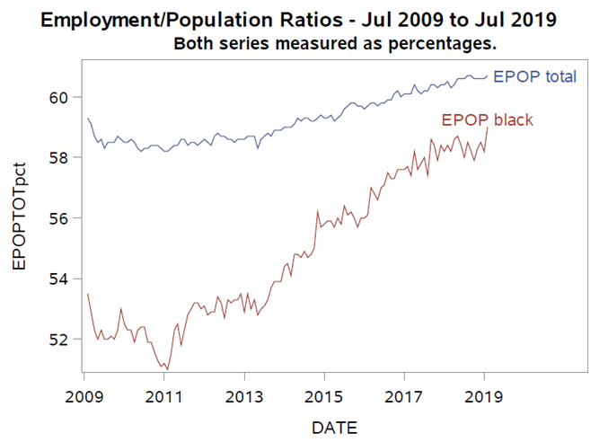
Examine Trends in Levels
title1 'Employment/Population Ratios - Jul 2009 to Jul 2019';
title2 'Series measured as percentages of the respective population.';
PROC SGPLOT data=work.temp;
series x=date y=EPOPTOTpct
/ curvelabel='EPOP total';
series x=date y=EPOPblackpct
/ curvelabel='EPOP black';
format date year4. ;
xaxis values=('1jun09'd to '1jul19'd by year);
run;

Slide 16
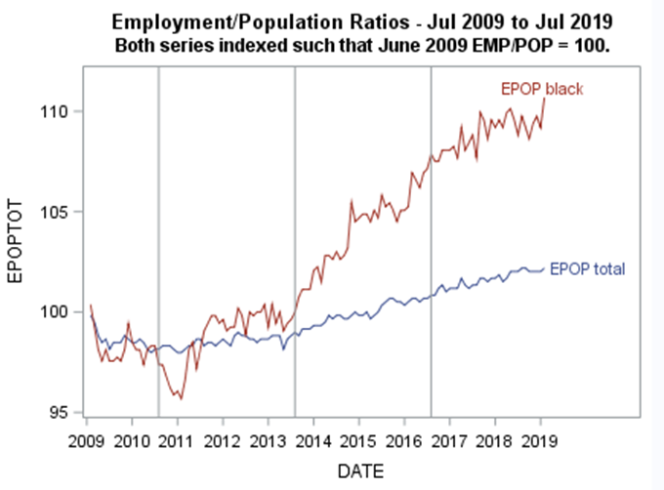
Examine Trends in Levels indexed to be identical on June 2009
title2 'Both series indexed such
that June 2009 EMP/POP = 100. ';
PROC SGPLOT data=work.temp;
series x=date y=EPOPTOT
/ curvelabel='EPOP total';
series x=date y=EPOPblack
/ curvelabel='EPOP black';
refline '1jan11'd '1jan14'd '1jan17'd / axis=x;
format date year4. ;
xaxis values=('1jun09'd to '1jul19'd by year);
run;

Slide 17
How do the two series behave over various time-slices of the post-recession months? Define group variable:
length group $9;
if date ge '1jan09'd and date lt '1jan11'd then group='2009-2010';
if date ge '1jan11'd and date lt '1jan14'd then group='2011-2013';
if date ge '1jan14'd and date lt '1jan17'd then group='2014-2016';
if date ge '1jan17'd and date lt '1jan20'd then group='2017-2019';

Slide 18
Characterizing Time Series using Tables
Table → Simple Statistics over portions of the time series
Central tendency of a series (Mean)
Measure of volatility (Standard Deviation)
Stability of the series (CV = coefficient of variation)
By Group
From: Silvia, Chapter 4, repeated in “SAS-speak” in Chapter 6.

Slide 19
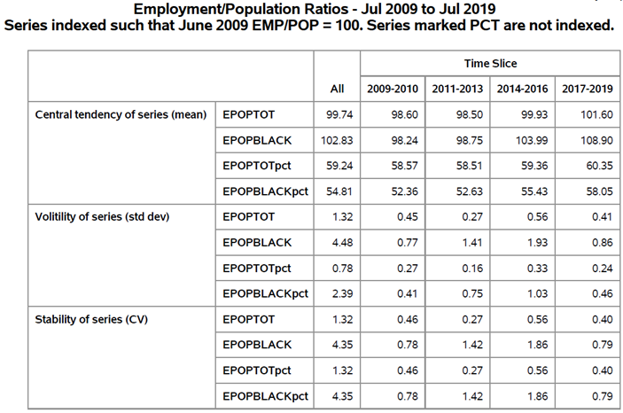
PROC TABULATE TO CHARACTERIZE THE SERIES
PROC TABULATE data=temp;
class group;
var epoptot epopblack
epoptotpct epopblackpct;
Table
(mean = 'Central tendency
of series (mean)'
stddev = 'Volitility of series
(std dev)'
cv = 'Stability of series (CV)')
*
(epoptot epopblack
epoptotpct epopblackpct)
,
(all group='Time Slice');
run;
Statistics
Row Variables
Column Variables

Slide 20
PROC TABULATE TO CHARACTERIZE THE SERIES

Slide 21
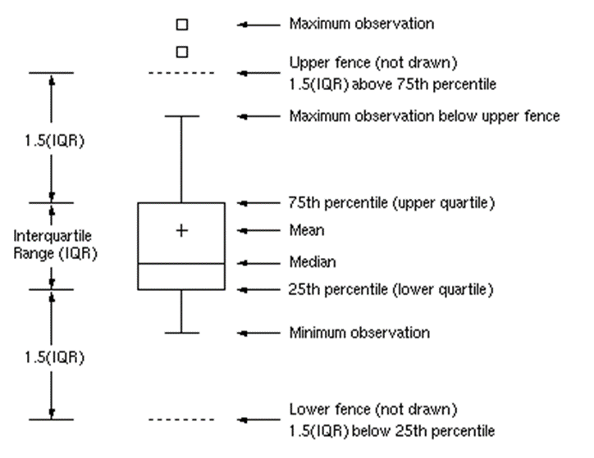
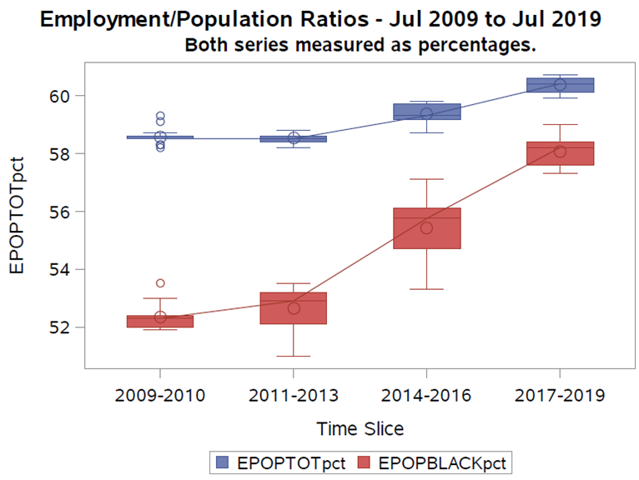
Focus on the Box Plot as part of Characterizing a Time-Series as EDA

Slide 22
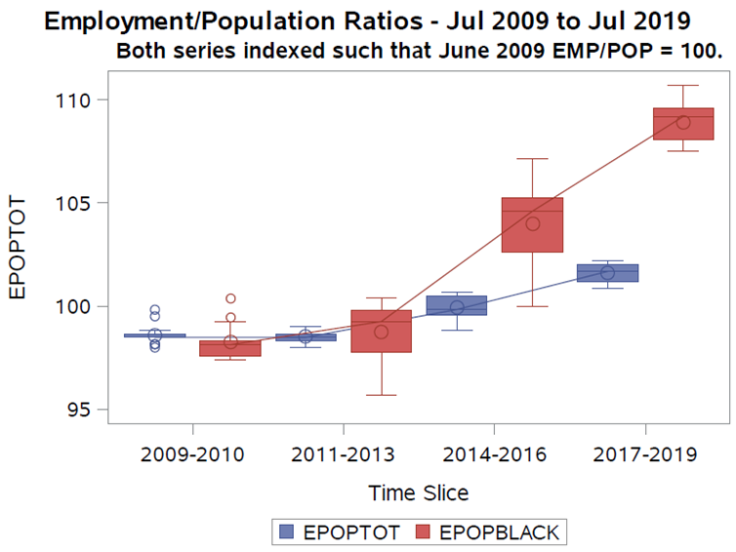
title2 'Both series indexed such that June 2009 EMP/POP = 100.';
PROC SGPLOT data=temp; label group='Time Slice';
vbox EPOPTOT / category=group boxwidth=0.40 discreteoffset=-0.25 connect=median;
vbox Epopblack/ category=group boxwidth=0.40 discreteoffset= 0.25 connect=median;
run;
title2 'Both series measured as percentages. ';
PROC SGPLOT data=temp ; label group='Time Slice';
vbox EPOPTOTpct / category = group boxwidth=0.50 connect=median ;
vbox Epopblackpct/ category = group boxwidth=0.50 connect=median ;
run;
And relative terms
Absolute level

Slide 23
Learn how to create useful transforms: The DIF Macro
%macro DIF(var,n_obs_per_year, id);
To explore time series economists make many transforms.
This macro automates the most common transforms and adds them to the current dataset.
Called by %DIF(var, n, id) where
‘var’ is the SAS variable name of variable to be transformed,
‘n’ is the number of observations in a year, and
‘id’ is a unique short abbreviation of the variable used in the naming.
Naming of the transforms consist of
PREFIX || (1 or n) || id
Example, for Percent change year over year of EMPBLACK would be
PCTD || n || EPB = PCTD4EPB (if the variable is quarterly)

Slide 24
Data Transformations: The DIF Macro
%macro DIF(var,n_obs_per_year, id);
For each variable passed to the DIF Macro
12 variable transforms of the original variable are calculated and added to the dataset.
Of these 7 are growth rates
Each lag and change is calculated at 1 period and n periods.
The changes are identical to the changes allowed in FRED graphs.
N_obs_per_year is
1 for Annual Data Frequency
4 for Quarterly
12 for Monthly
26 for Bi-weekly
52 for Weekly

Slide 25
Data Transformations: The DIF Macro – partial code
%macro DIF(var,n_obs_per_year, id);
/* level variable */
LEV_&id = &var;
/* lag variable */
LAG1&id=lag(&var);
/* if Y = variable on the RHS, this gives y(t-1) */
/* lag n_obs_per_year variable */
LAG&n_obs_per_year&id=lag&n_obs_per_year(&var);
/* if Y = variable on the RHS, this gives y(t-1) */
/* Log of variable*/
LOG&id=log(&var);
/* if y = variable on RHS, this gives ln(y) */
/* Lag of log variable*/
LAGLOG&id=lag(LOG&id);
/* if y = variable on RHS, this gives ln(y) */
/* Change from one period ago */
D1&id=dif1(&var);
/* if y = variable on RHS, this gives y(t)-y(t-1) */
/* Change from 1 Year ago */
D&n_obs_per_year&id=dif&n_obs_per_year(&var);
/* if y = variable on RHS, this gives y(t)-y(t-1) */
/* percent change in variable, period over period */
PCTD1&id= ((&var / LAG1&id)-1)*100;
/* if y = variable on RHS, this gives [y(t)/y(t-1)-1]*100 */
/* Other lines omitted for space */
%mend;

Slide 26
Variable | Prefix | Math representation | SAS CODE
level | LEV_ | Y_{t} | LEV_&id = &var;
One period lag | LAG1 | Y_{t-1} | LAG1&id = lag(&var);
One year ago lag | LAGn | Y_{t-n} | LAG&n_obs_per_year&id =lag&n_obs_per_year(&var);
Change from one period ago | D1 | Y_{t} – Y_{t-1} | D1&id=dif1(&var);
Change from 1 Year ago | Dn | Y_{t} – Y_{t-n} | D&n_obs_per_year&id =dif&n_obs_per_year(&var);
Percent change in variable, period over period | PCTD1 | ((Y_{t}/Y_{t-1})-1)*100 | PCTD1&id=((&var/LAG1&id)-1)*100;
Percent change from one year ago, year over year | PCTDn | ((Y_{t}/Y_{t-n})-1)*100 | PCTD&n_obs_per_year&id =((&var / LAG&n_obs_per_year&id)-1)*100;
Compounded Annual Rate of Change | CARCn | (((Y_{t}/Y_{t-1})^{n})-1)*100 | CARC&n_obs_per_year&id =(((&var/LAG1&id)**&n_obs_per_year )-1)*100;
Log of variable | LOG | lnY_{t} | LOG&id=log(&var);
Lag of log variable | LAGLOG | lnY_{t-1} | LAGLOG&id=lag(LOG&id);
Continually Compounded Rate of Change | CCR | (lnY_{t} - lnY_{t-1})*100 | CCR&id=(LOG&id-LAGLOG&id)*100;
Continually Compounded Annual Rate of Change | CCAR | (lnY_{t} - lnY_{t-1})*100*n | CCAR&id =(LOG&id-LAGLOG&id)*100*&n_obs_per_year;

Slide 27
The Explore Macro
%macro explore(n);
%let var_list = LEV_ D&n PCTD&n CARC&n CCAR;
%local i next_name;
%local j next_var;
%do i=1 %to %sysfunc(countw(&name_list));
%let next_name = %scan(&name_list, &i);
%do j=1 %to %sysfunc(countw(&var_list));
%let next_var = %scan(&var_list, &j);
%** DO whatever needs to be done for &NEXT_NAME;
statements removed for clarity
%end;
%end;
%mend;
To call the explore macro you specify a name_list of the ids used to create the transforms in the DIF Macro.
Inside of the macro you list the prefixes of the data transforms that you want for each variable in the name list.
To CALL
%let name_list = EPT EPB;
%explore(12);

Slide 28
What is done for each
Title "Variable &next_var&next_name";
PROC TABULATE data=temp;
class group;
var &next_var&next_name;
Table ( mean='Central tendency of series (mean)' stddev='Volitility of series (std dev)' cv='Stability of series (CV)')*
(&next_var&next_name ), ( all group='Time Slice');
run;
PROC SGPLOT data=work.temp;
loess x=date y=&next_var&next_name ;
series x=date y=&next_var&next_name ;
format date year4. ;
xaxis values=('1jun09'd to '1jul19'd by year);
run;
PROC SGPLOT data=work.temp;
vbox &next_var&next_name / category = group
boxwidth=0.50 connect=median;
run;

Slide 29
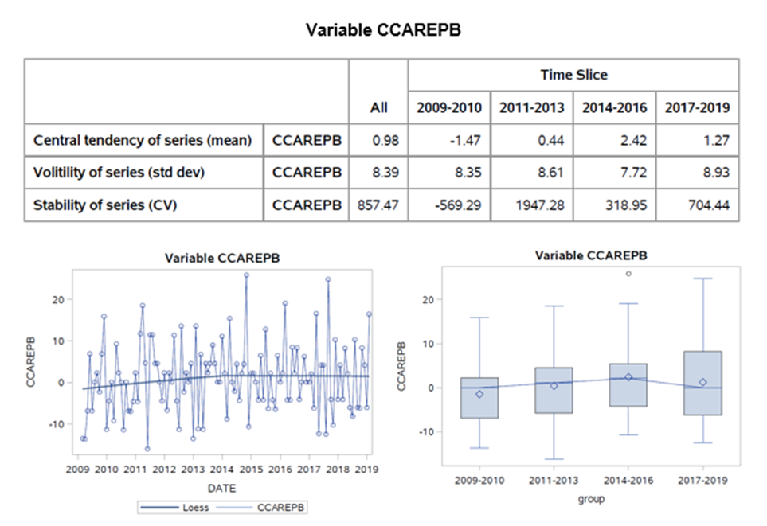
Sample output of Explore Macro for prefix=CCAR and id=EPB

Slide 30
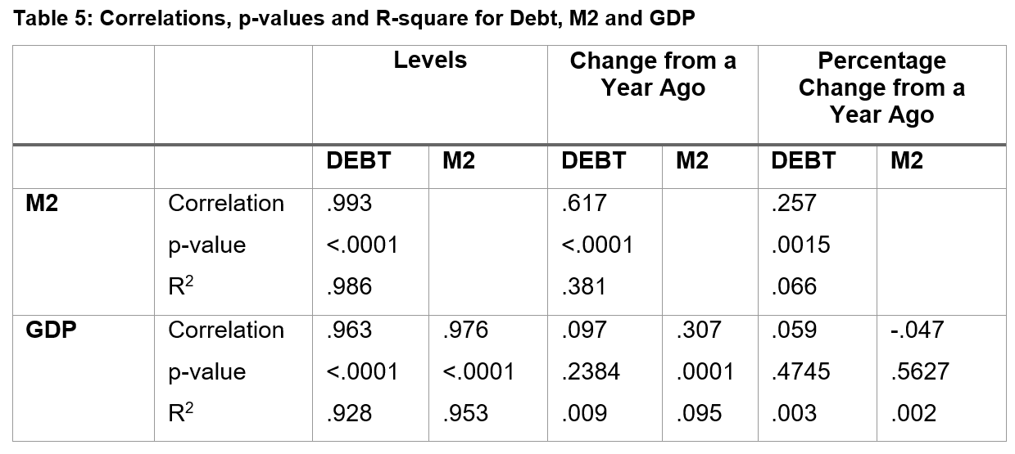
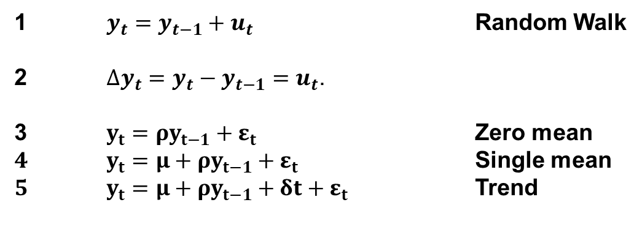
What is a random walk and why should I care?
$y_{t}=y_{t−1}+u_{t}$ Random Walk
$∆y_{t}=y_{t}−y_{t−1}=u_{t}$.
3 $y_{t}=ρy_{t−1}+ε_{t}$ Zero mean
$4$ $y_{t}=μ+ρy_{t−1}+ε_{t}$ Single mean
$5$ $y_{t}=μ+ρy_{t−1}+δt+ε_{t}$ Trend
R²=.99
R2=.07

Slide 31
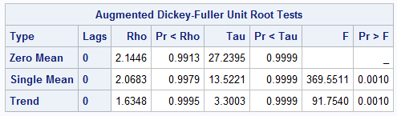
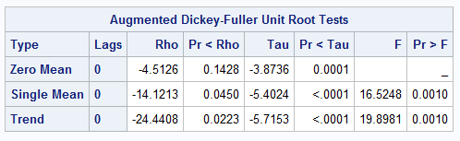
Identification – Proc Autoreg
Table 3: ADF Tests of a unit-root in the money supply, (M2)
proc autoreg data=gdpm2;
model m2=
/stationarity=(adf=0);
model PCTD4CPI=
/stationarity=(adf=0);
run;
Table 4: ADF Tests of a unit-root in Inflation (PCTD4CPI)
adf=0
Assumes no serial correlation in the two series. adf=k should be used once the series has been defined.

Slide 32
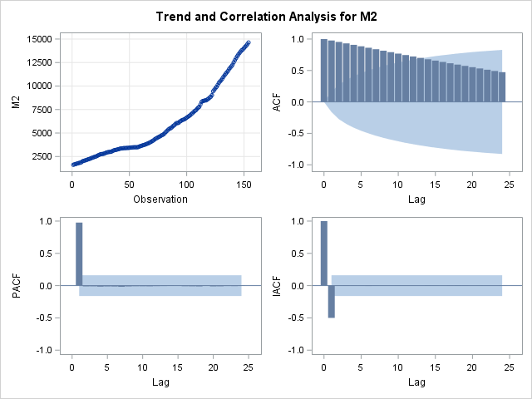
Identification of the DGP– PROC ARIMA
PROC ARIMA data=gdpm2;
identify var=m2 stationarity=(ADF=0);
run;

